Slide 1
Building Fluent Readers
Core Advocates Monthly Webinar
April 5, 2017
The webinar will begin shortly. You may wish to download the handouts (check the tab on your webinar control panel) while you wait.

Slide 2
Introductions
Your hosts from the Field Impact Team
Sandra Alberti, Director
Janelle Fann, Project Manager
Jennie Beltramini, Teacher Engagement Manager
This Month’s Guests
David Liben, SAP
Lorraine Griffith, Core Advocate

Slide 3
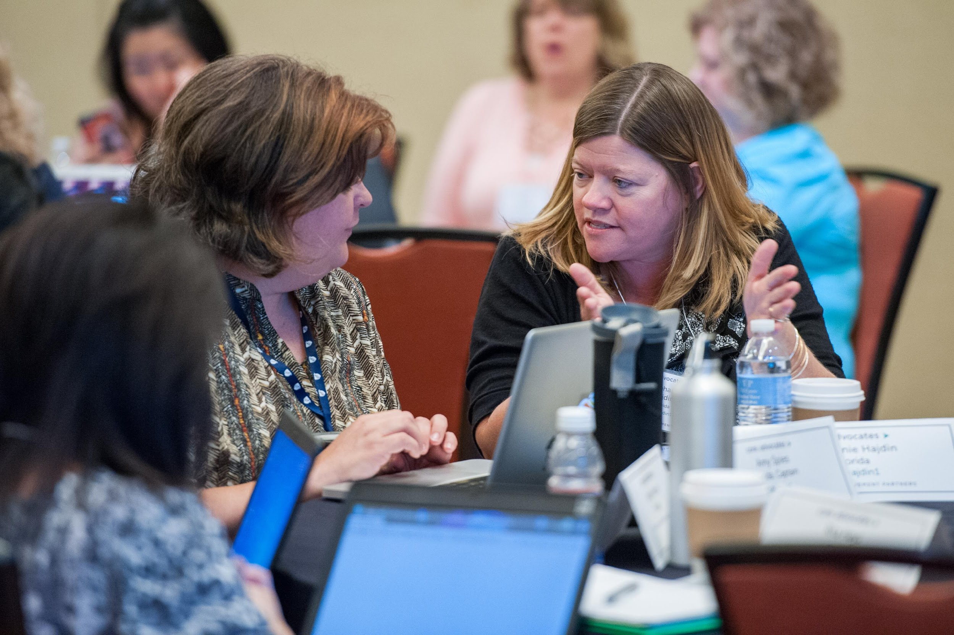
Who are Core Advocates?
Core Advocates are educators who:
  Believe in the potential of the CCSS to prepare all students for college and careers;
  Are eager to support their colleagues and communities in understanding and advocating for the CCSS and CCSS-aligned instruction;
  Understand and embrace the shifts in instruction and assessment required by the CCSS

Slide 4

To learn more about Core Advocates…
Contact Jennie Beltramini (jbeltramini@studentsachieve.net ) or Joanie Funderburk (jfunderburk@studentsachieve.net)
Complete this survey to join our database (and mailing lists): http://achievethecore.org/ca-signup
Visit our website: www.achievethecore.org

Slide 5

Tweet with us
Please feel free to tweet during and after the webinar using #coreadvocates
@achievethecore
@JoanieFun, @salberti, @JennieBeltro

Slide 6
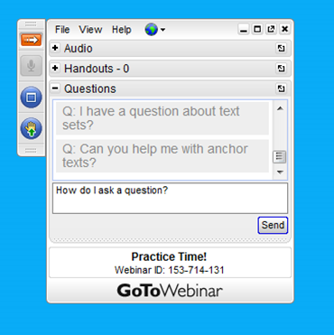
Webinar protocols
During the webinar
– Accessing Documents
– Questions option
– Polling
After the webinar
– Survey
– Access to recorded webinar

Slide 7
Instructional Advocacy – A Definition
Grounded in a firm understanding of the Shifts, educators owning, supporting, and promoting the resources, tools, and practices that create learning environments in which students develop college- and career- readiness.

Slide 8
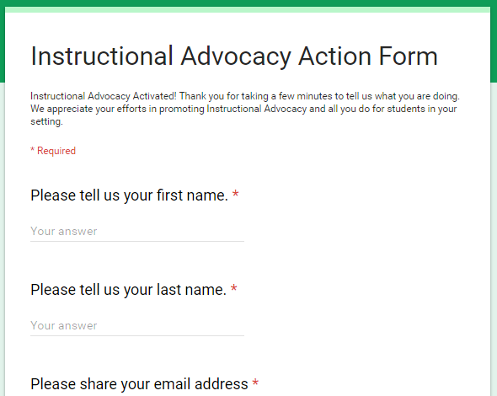
Tell us about your efforts
www.achievethecore.org/educators-taking-action

Slide 9
Areas of Focus of the Webinar
What is fluency and why is it important?
What can teachers do about dysfluency?
What tools and resources are available to support this work?

Slide 10
What is fluency and why is it important?

Slide 11

What is fluency?
The ability to read grade level text with accuracy, automaticity and expression
Grade level!

Slide 12
Why is fluency important?
Reading too slowly makes comprehension far more difficult--especially with complex text
Poor word recognition makes comprehension far more difficult
The combination makes comprehension even more difficult
Research shows a college- and career-ready student learns 2500-3000 words a year
Affects ALL subjects

Slide 13

Accumaticity and how it connects to fluency
Accumaticity = wcpm (words correct per minute)
- Without accumaticity fluency is impossible
- Accumaticity is necessary but not sufficient to be
fluent

Slide 14
Poll:
How many listeners work within the following grade bands?
Please use the poll to select your answer

Slide 15
Question or Poll:
Do you have a fluency routine in your setting?
Please use the poll to select your answer

Slide 16
How can teachers support students’ fluency?

Slide 17
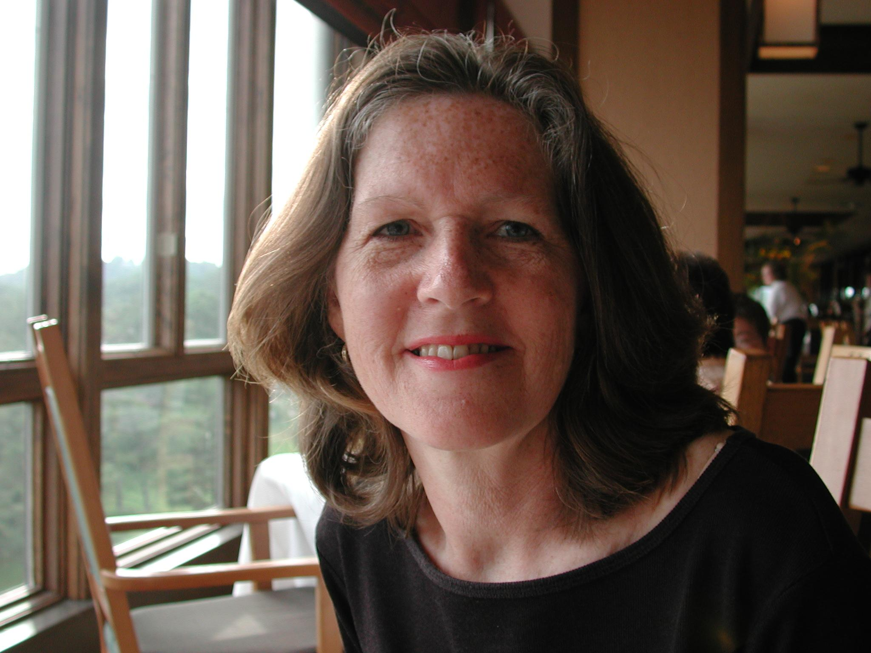
Special Guest Core Advocate:
Lorraine Griffith
Classroom Teacher K, 4, 5
Reading Specialist K-4
(Recently Retired after 27 years)
Content Architect, Humanities, Great Minds

Slide 18
Classroom Practices to Support Fluency
The Practices -- Tim Rasinski’s Readers’ Theater
Year 1: Readers’ Theater
Year 2: Readers’ Theater & Timed Reads
Year 3: Readers’ Theater & Monologues, Partner Reading, Timed Reads

Slide 19
Classroom Practices to Support Fluency
The Impact (3 year study)
Joyful Rigor
1.17 year gain to 2.87 years gain
22% to 93% on grade level at end of grade 4

Slide 20

Classroom Practices (con’t)
Since the study…
Songs
Rhythm waits for no one
Great success with English Learners
Poetry
“Read to the Punctuation”
FUN!
Poems for Two Voices
Passages
Chosen for multiple purposes
An I Can attitude

Slide 21
How do we get students to fluency?
Work in early grades
Accumaticity in K-2 is essential!
A student on track to be college- and career-ready should recognize words in .23 seconds. No hesitation.
Recent research on accumaticity -- David D. Paige, in 10 states with more than 10,000 students, between 25%-70% are dysfluent. The higher the grade, the more dysfluent students.
How did we get to this problem? -- Lack of structured phonics

Slide 22

The importance of getting kids fluent before grade 3
Text starts to get more complex here
Dysfluency takes the joy out of reading
If a student is dysfluent...

Slide 23
A brief mention on time
Research shows students in K-2 require 45-60 minutes per day in foundational skills of print, phonics and fluency
An example from a 10th grade history class - primary source documents
Fluency can be fixed

Slide 24
Which fluency strategies seem doable to start immediately (indicate your grade level)?
(Please use the Question Box to respond.)

Slide 25
What resources are available to support this work?

Slide 26

Achieve the Core Resources
“At the Foundation of Foundational Skills: Structured Phonics” on Aligned Blog
Fluency Resources on Achieve the Core
Fluency Packets

Slide 27
Other Resources
Dr. Edward Fry’s Instant Word List
Complex Text, including speeches

Slide 28
Questions for webinar guests?

Slide 29
Instructional Advocacy – A Definition
Grounded in a firm understanding of the Shifts, educators owning, supporting, and promoting the resources, tools, and practices that create learning environments in which students develop college- and career- readiness.

Slide 30
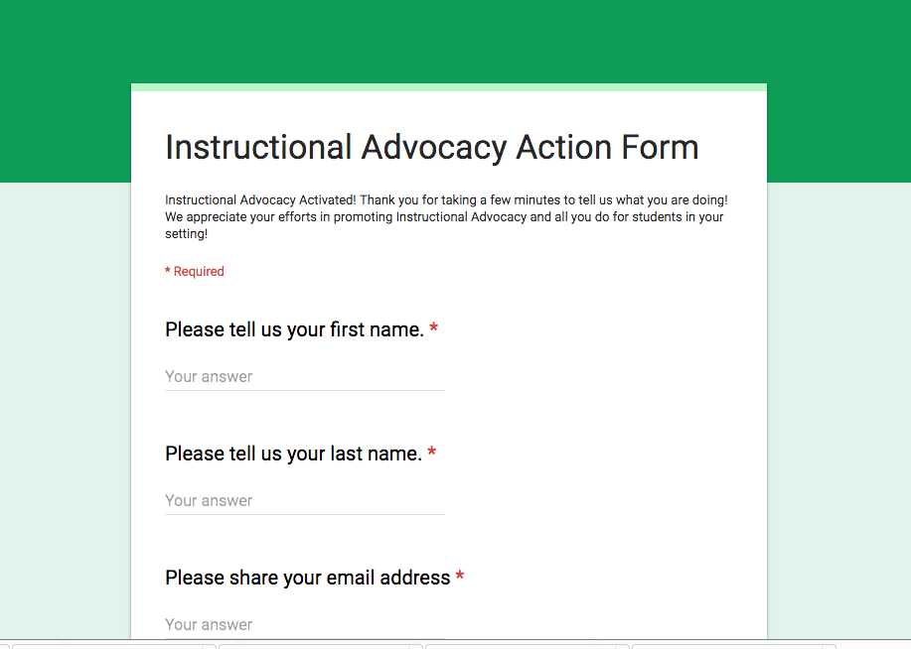
Tell us about your successes
www.achievethecore.org/educators-taking-action

Slide 31
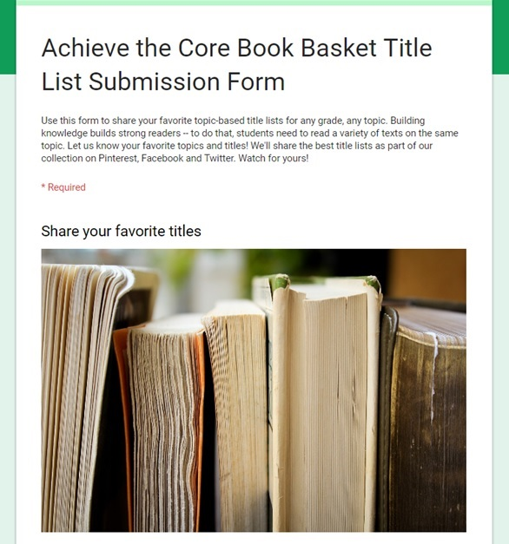
Book Baskets Project
Building knowledge builds strong readers -- to do that, students need to read a variety of texts on the same topic. Let us know your favorite topics and titles!
Share your favorite topic-based title lists for any grade, any topic.
We'll share the best title lists as part of our collection on Pinterest, Facebook and Twitter. Watch for yours!

Slide 32
Special Webinar/Live Twitter Chat next month
Review one of our past webinars: “A Different Look at the Causes of the Achievement Gap” with David Liben or “Rigor in Math: Why Rigor Doesn’t Mean Harder” with Marni Greenstein between now and May 3rd.
Log on to Twitter at 7:00 pm EDT on May 3rd for a live chat about the recording!
  #coreadvocates
  #MayCA-ELA or #MayCA-math

Slide 33
Thank You!

